Slide 1
2026
Word of the year

Slide 2
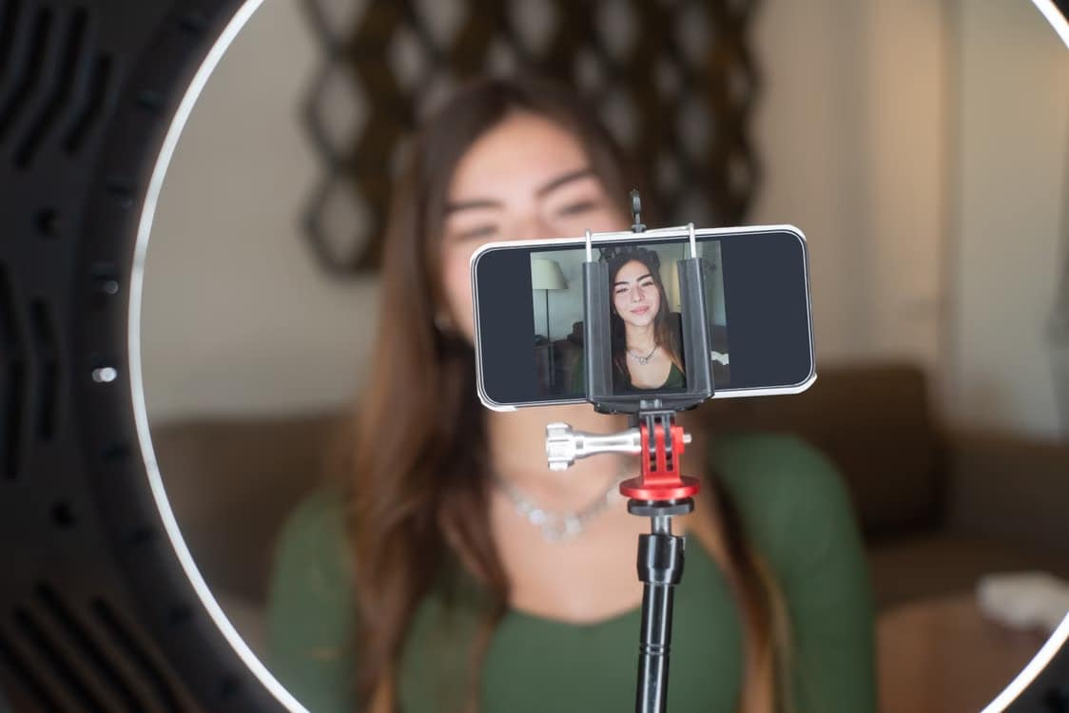
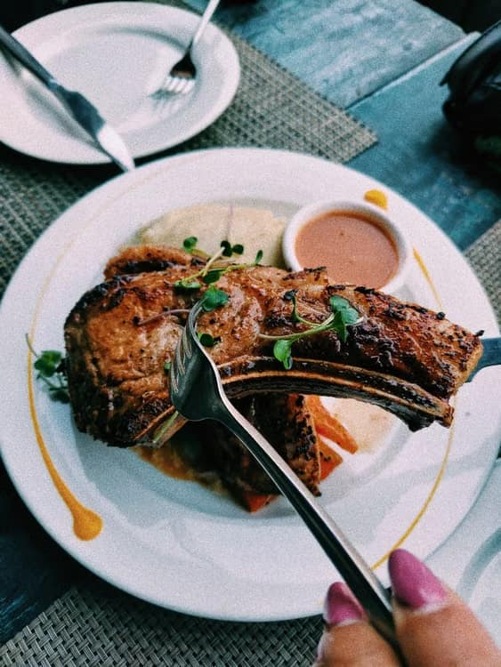
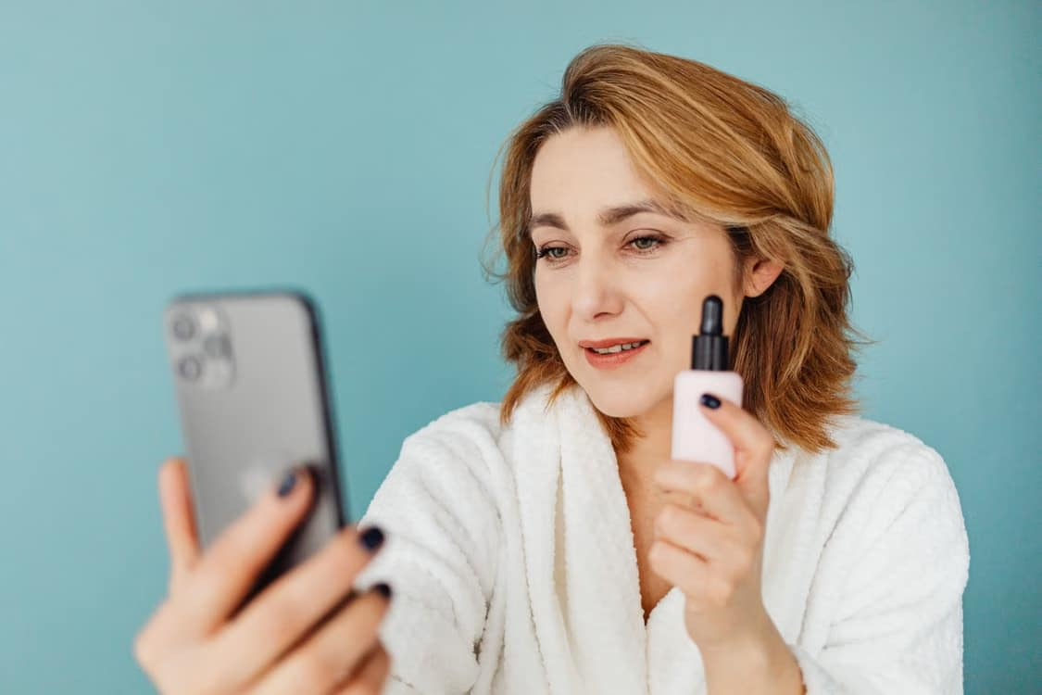
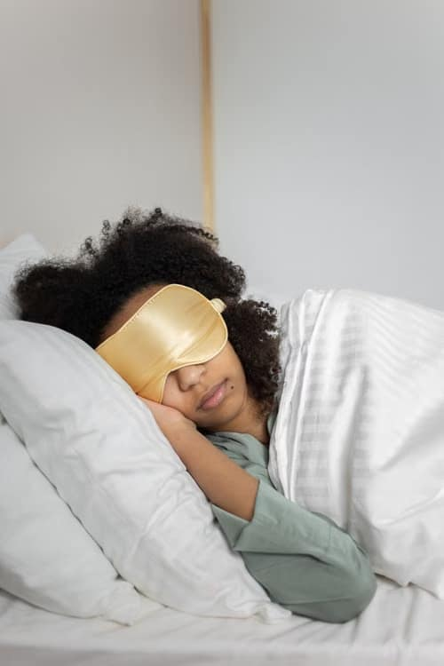



You are going to read an article about the 2026 ‘Word of the year’. Look at the pictures and try to predict what the word will be, or what it might be related to.
#hashtag
@marv.maxed

Slide 3
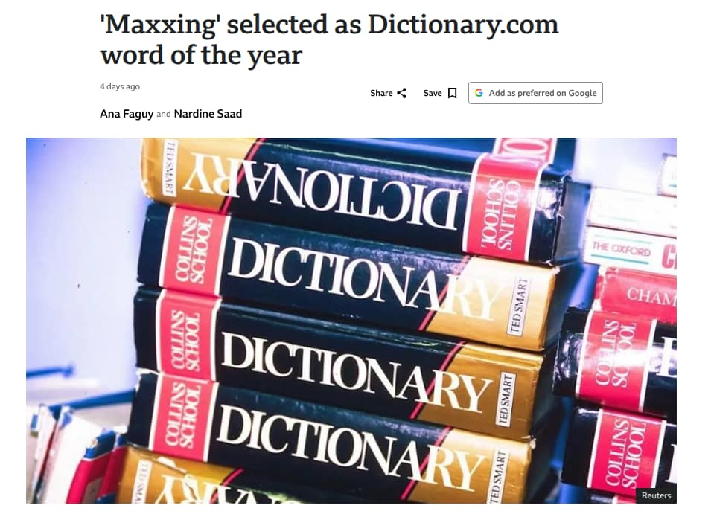
Read the title of the article. Have you heard of this word before?

Slide 4
Do you think it’s an appropriate choice for the Word of the Year 2026? If so, why? If not, why not and which word may be a better choice in your opinion?

Slide 5
Exercise 1: Match the phrases from the text with their definitions
Phrase | Definition
Go all in (verb)
A major departure from (noun phrase)
Push it further (verb)
For laughs (prepositional phrase functioning as an adverb)
Fall out of favour (verb)
Get the most out of (something) (verb)

Slide 6
Discussion: Vocabulary in context

Slide 7
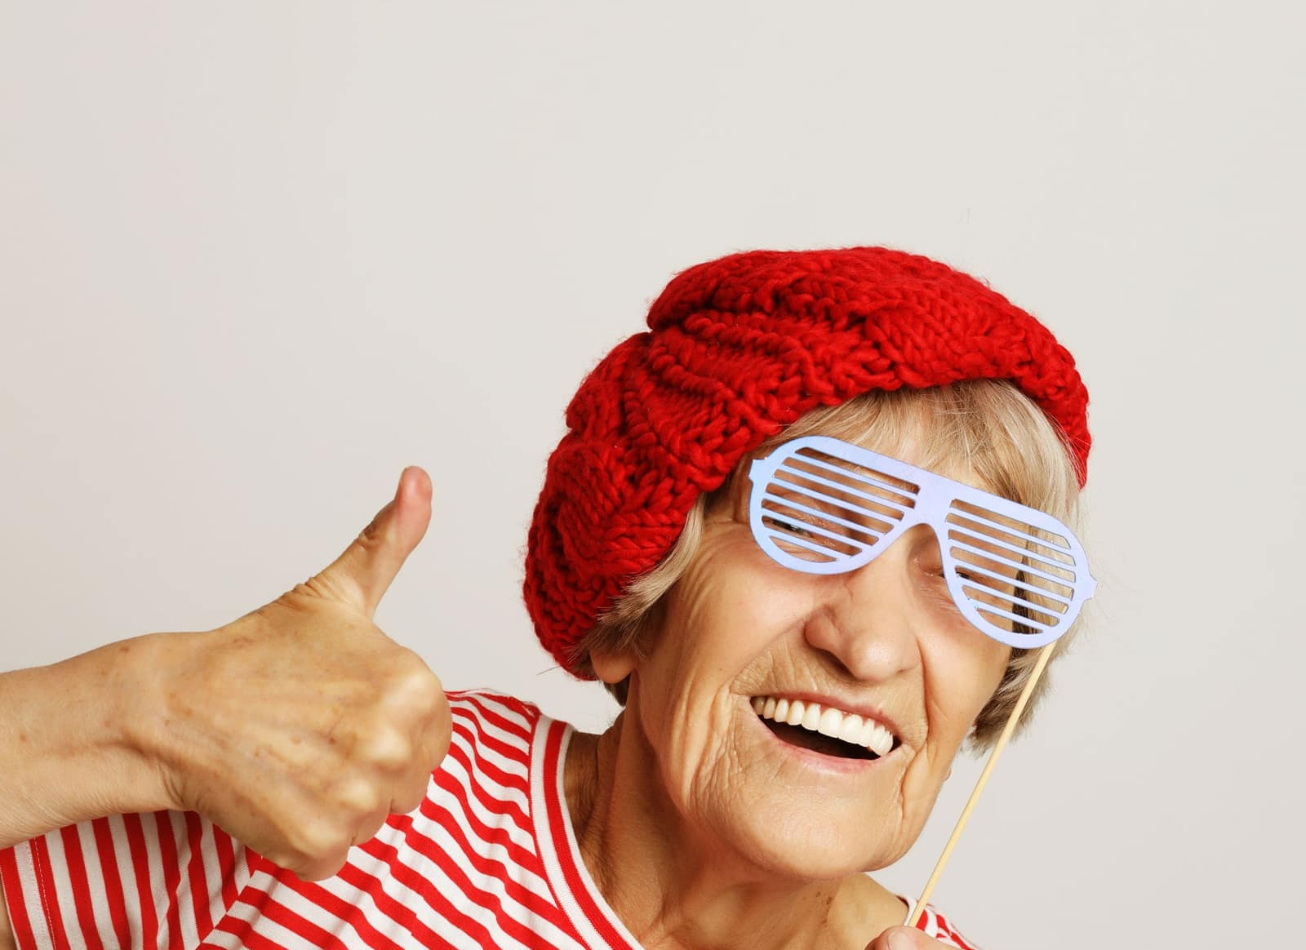
The article states that some people engage in ‘maxxing’ for laughs, meaning they don’t take it seriously. Have you ever done something for laughs? What are some activities you can do for laughs?

Slide 8

Have you ever gone all in when playing poker, or when doing another activity? What was the result?

Slide 9
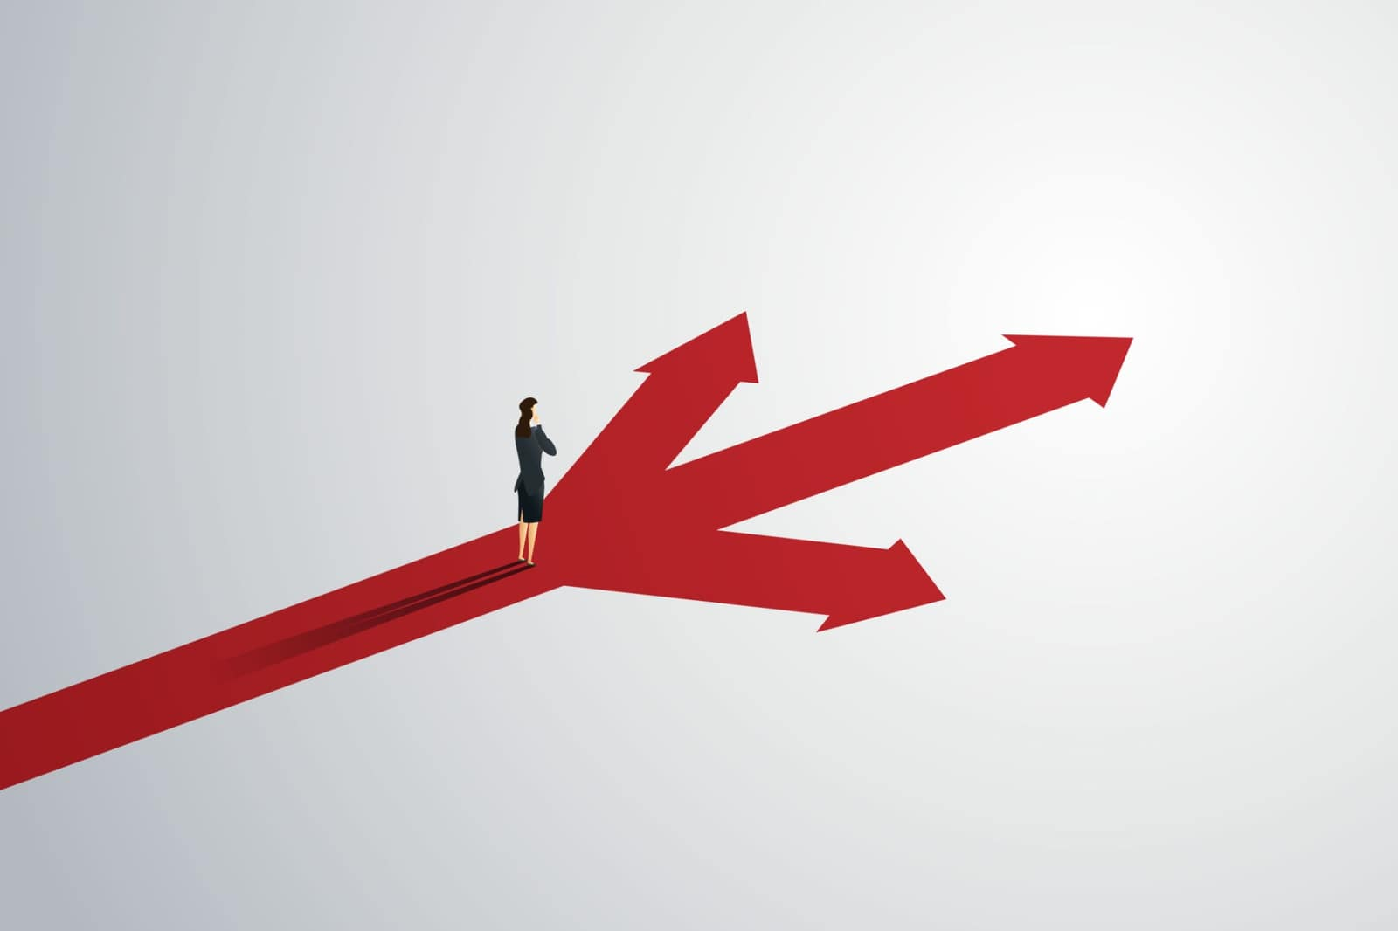
Give an example of a time when something in your life took a major departure from what was normal for you at the time.

Slide 10

You are working hard to improve your English, which is amazing! How can you push it even further?

Slide 11
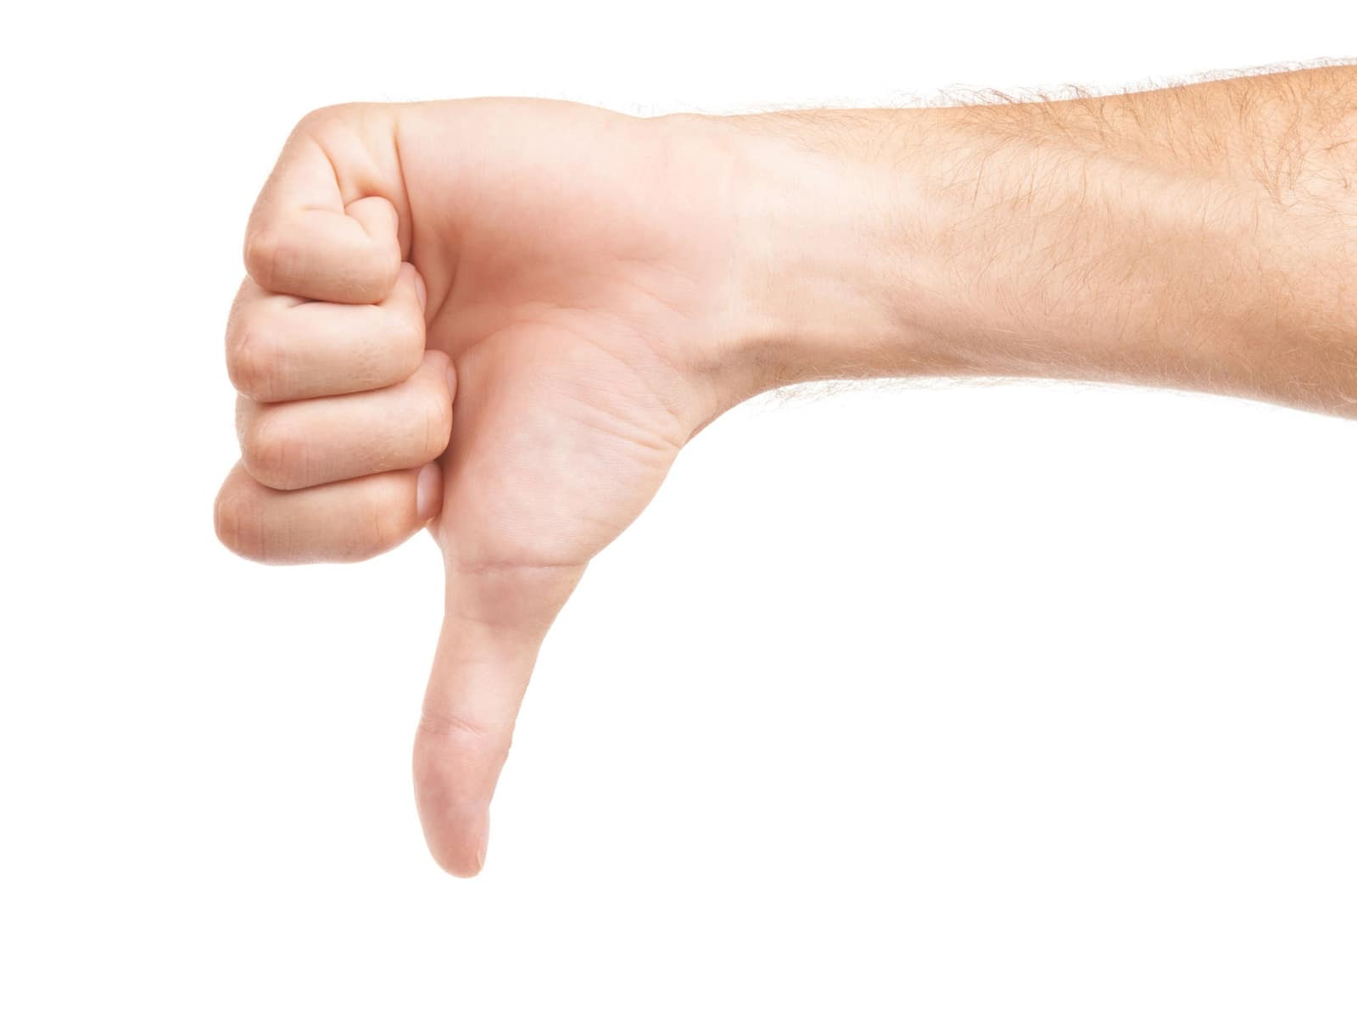
Give me an example of something which was once very popular, but has now fallen out of favour?

Slide 12

How do you get the most out of your free time?

Slide 13
Discussion: The text

Slide 14
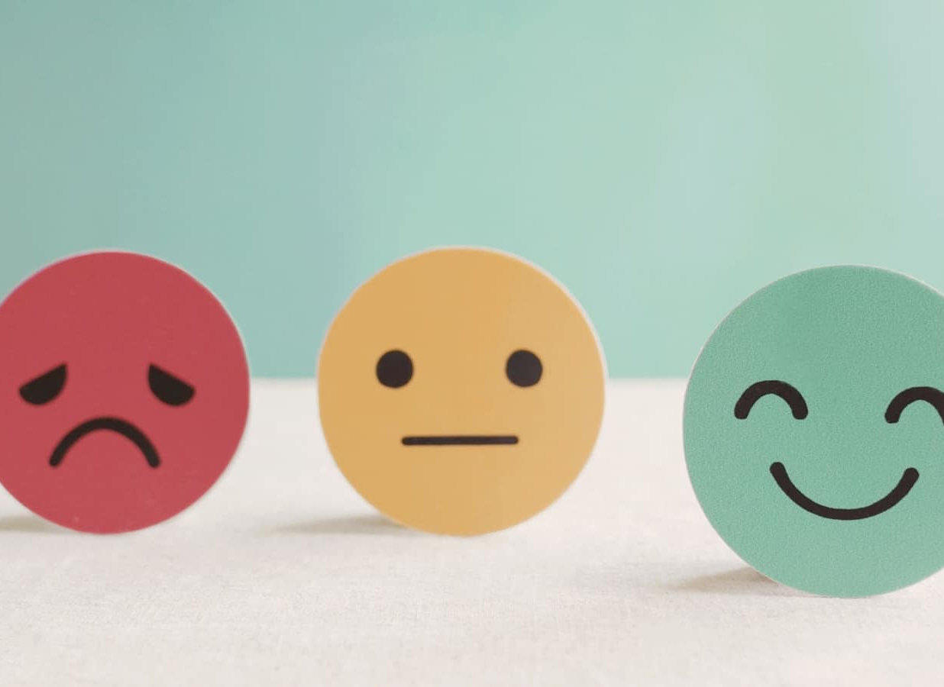
Give me an example of harmless maxxing and one example of harmful maxxing, in your opinion.

Slide 15

"Maxxing is the linguistic manifestation of a culture increasingly preoccupied with getting the most out of everything” - Do you agree that our culture is “increasingly occupied with getting the most out of everything”?
Why or why not?

Slide 16

“The site also considered affordability, data centre, and odyssey as potential words of the year.” - Why were these words also options? In your opinion, would one of these have been a better choice?

Slide 17
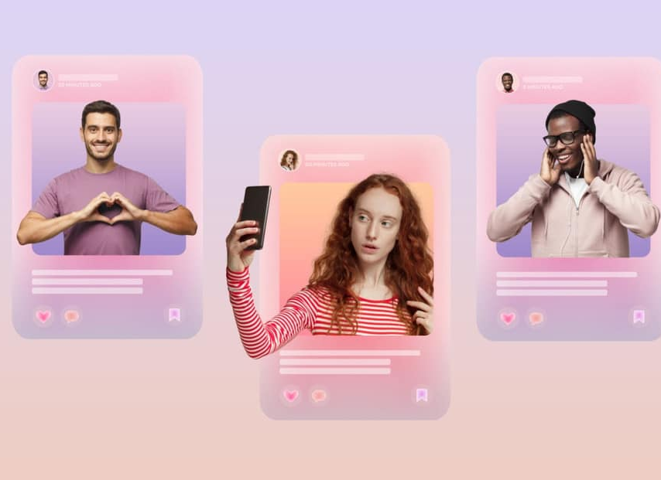
The article states that people under 30 “post extensively about their maxxing efforts to achieve all sorts of perfection.” - In your opinion, is this trend negative or positive? Why? What do you think contributes to this trend?

Slide 18

An expert in the text states: "By the time millennials and older generations start using the terms, Gen Z and Gen Alpha aren't using those terms anymore," - Have you ever experienced this? Give some examples of the different ways the different generations communicate.

Slide 19
Englishmaxxing!

Slide 20

Extra task: Do some research

Slide 21
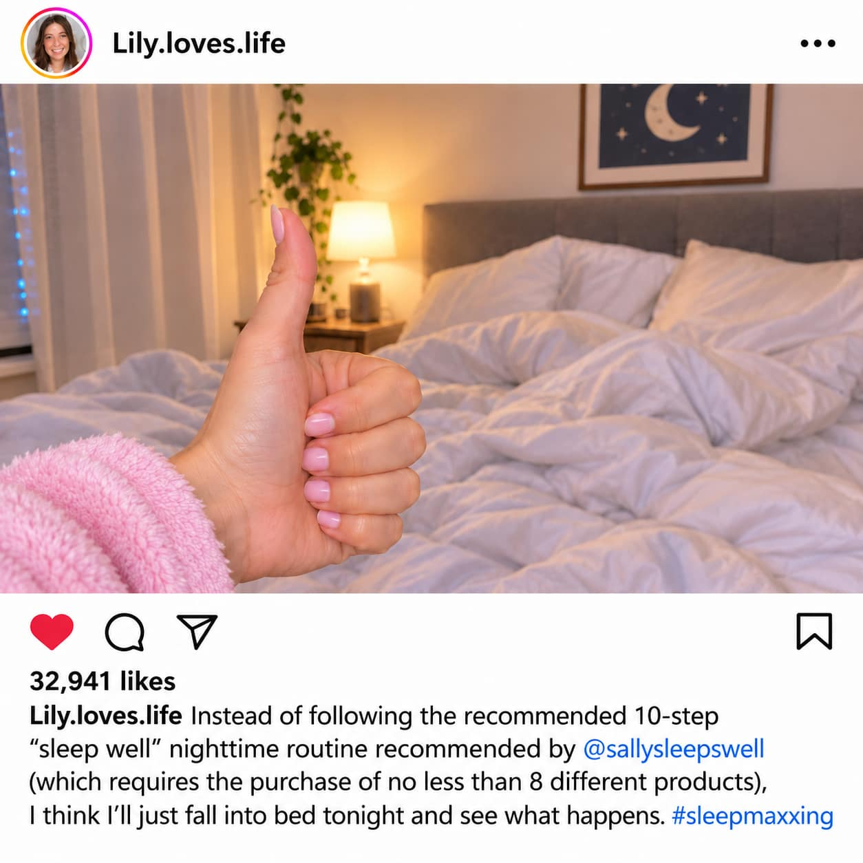
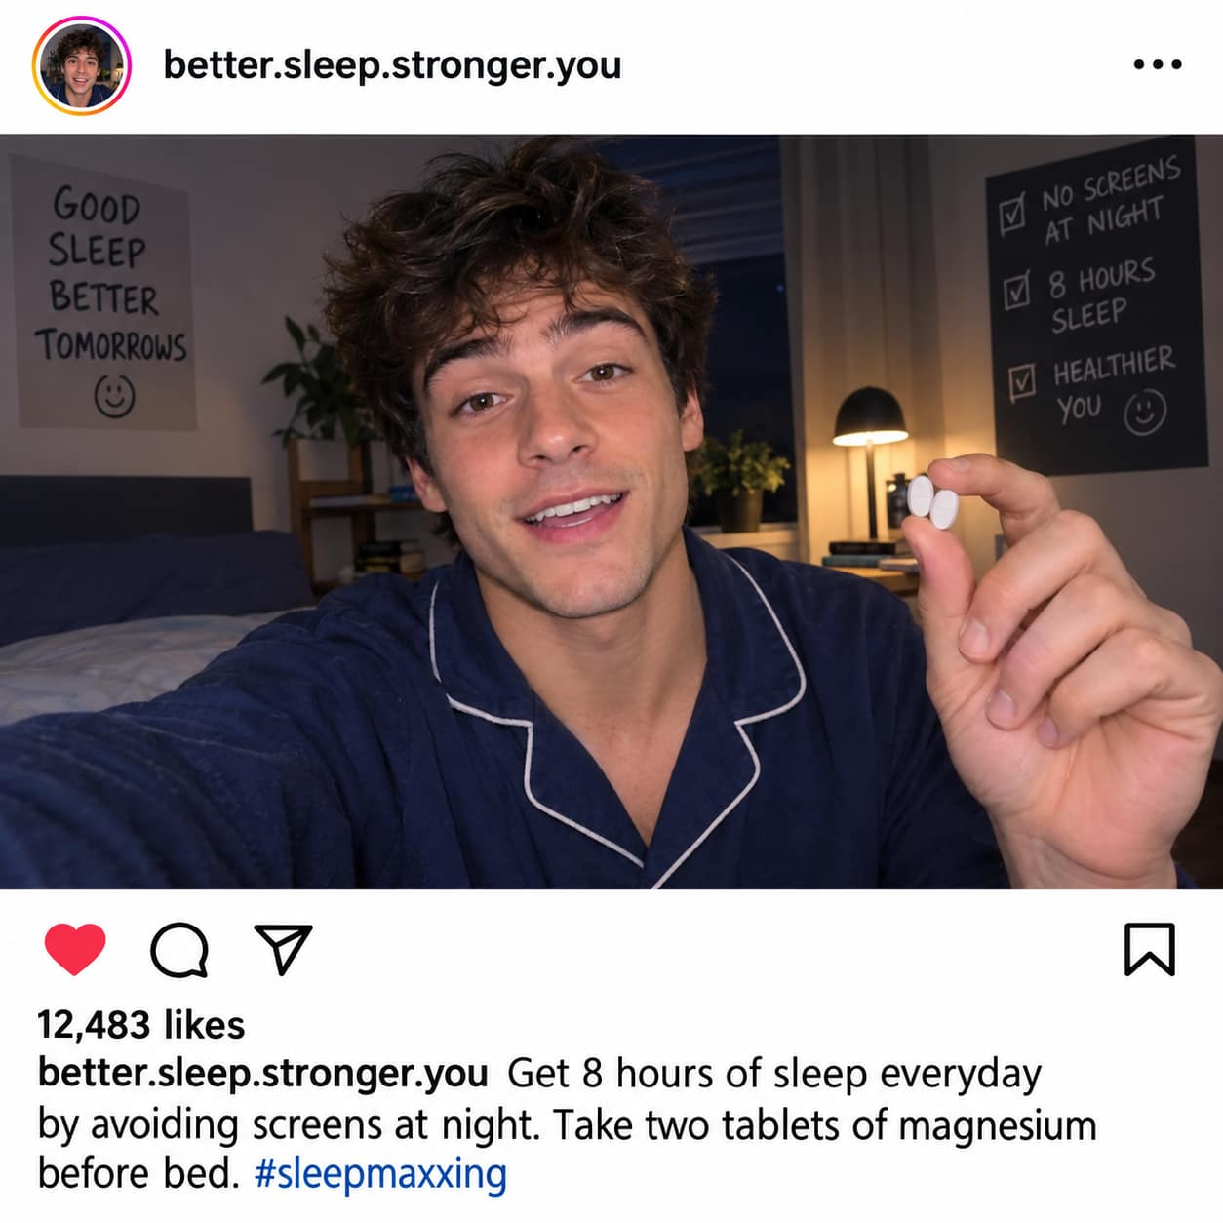
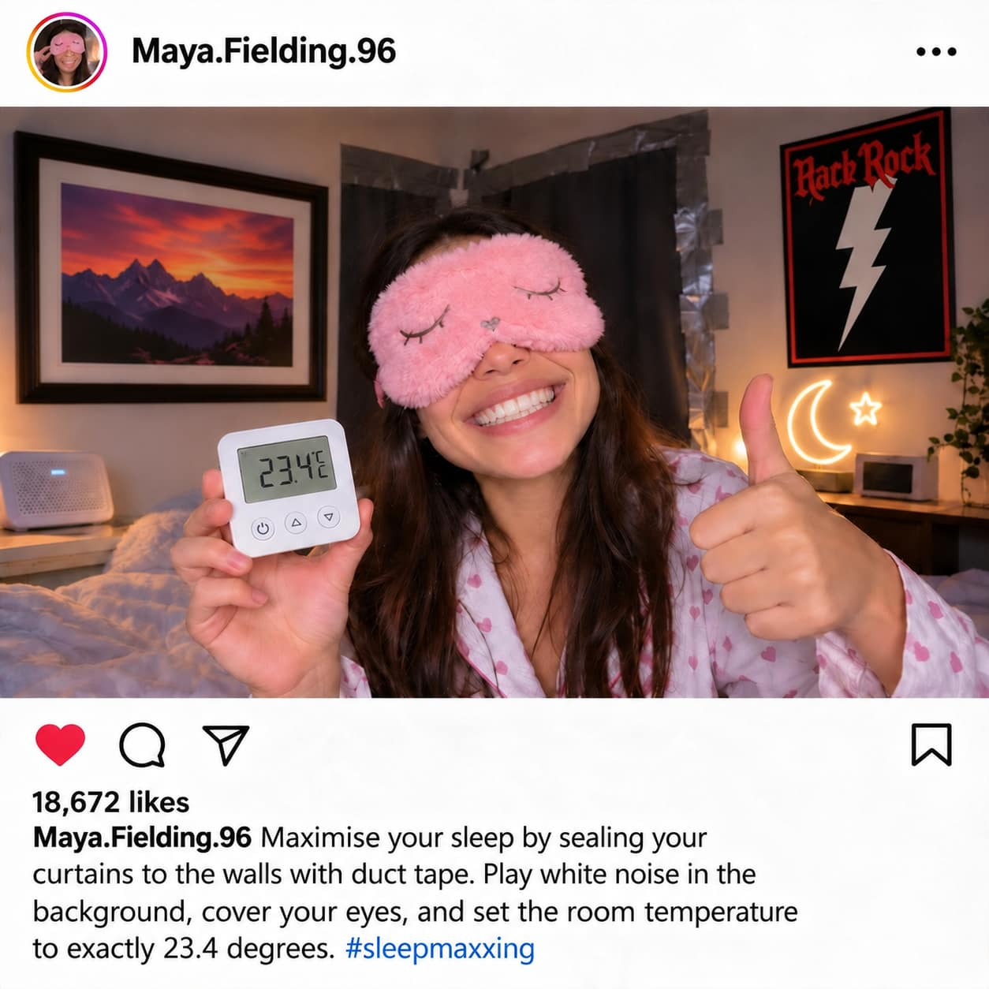
Extra task: Making the most of maxxing, or doing it for laughs?
Consider the three social media posts below. Which person is taking sleepmaxxing seriously, which person is exaggerating the trend, and which one is doing it mundanely?
Posts have been generated using AI (artificial intelligence).

