Slide 1

Trump’s crypocurrency
ESL Lesson
www.emmateachesenglish.org

Slide 2

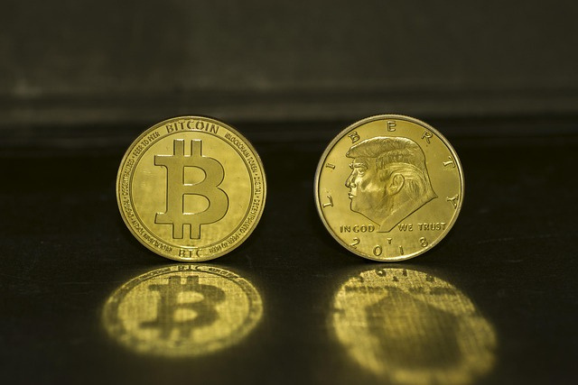
Look at the images below. What, or who, do they show? Discuss how they could be related.
www.emmateachesenglish.org

Slide 3

Find/think of an example of a cryptocurrency and present it to the class
What is the name of the cryptocurrency, who released it, and when?
01
When did it experience big increases in its worth? Were there any decreases?
02
Is this a cryptocurrency you would buy? Why or why not?
03
www.emmateachesenglish.org

Slide 4
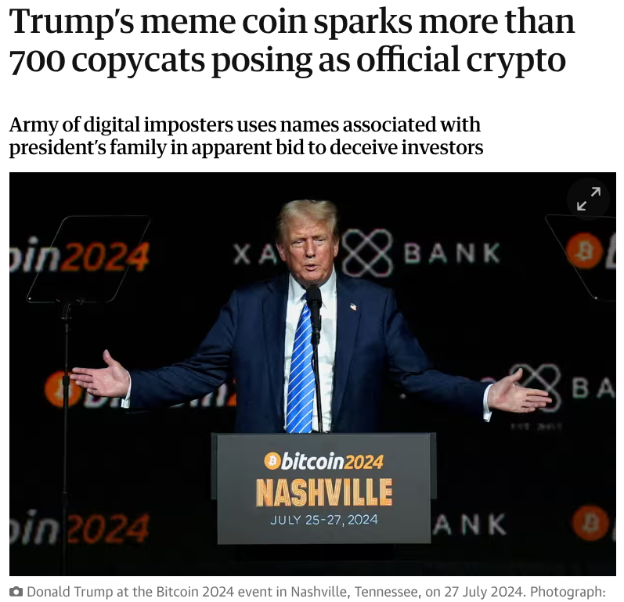
You are going to read the article shown on the right.
Before reading:
  What is the word ‘crypto’ short for?
  What is a ‘copycat’?
  Why might people decide to be copycats?
  What information do you expect to read in this article?
Original article
www.emmateachesenglish.org

Slide 5
After reading
  What are your thoughts on the topic of this article? Use three adjectives to describe them and explain your choices.
  Do you think this journalist is pro or anti-Trump? Why?
  Has this article reinforced or challenged your views on cryptocurrencies? How?
Original article
www.emmateachesenglish.org

Slide 6
Focus on vocabulary
www.emmateachesenglish.org

Slide 7

Discussion: Can you think of an example of a person or company who was or is ahead of the game? What actions did they take to be in their position?
www.emmateachesenglish.org

Slide 8

Discussion: Can you think of an example of a person or company who made a killing? How did they do it?
www.emmateachesenglish.org

Slide 9
Discussion: Can you think of an example of a person, company or trend who/which sparked a slide in something (e.g. financial value, the use of a product/service, an activity etc)?
www.emmateachesenglish.org

Slide 10

Discussion: When was the last time you heard of a person, organisation, or team being taken to the cleaners?
www.emmateachesenglish.org

Slide 11

Discussion: Fill in these gaps with your own idea:
“…………………. has opened the floodgates to/for ……………………………”
www.emmateachesenglish.org

Slide 12

Discussion: Have you ever dallied in the cryptocurrency market?
If not, why not?
If yes, what was your experience like? What advice would you give to people considering it?
www.emmateachesenglish.org

Slide 13

Discussion: Can you think of a time when there was a precipitous change in either your personal life, or elsewhere (such as in your country, or in financial markets)?
www.emmateachesenglish.org

Slide 14

Discussion: Provide some other examples of grifting. What can be done to stop it?
www.emmateachesenglish.org

Slide 15

Discussion: What is something you dallied with in your life. Why didn’t you continue doing it?
www.emmateachesenglish.org

