Slide 1

Feel the flamenco
ESL Lesson
www.emmateachesenglish.org

Slide 2
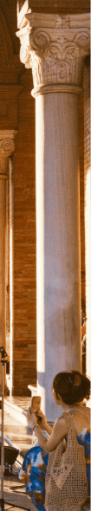
Look at this section of an image. What information does it give you about the possible theme of today’s lesson?
  What is the woman doing?
  Why do you think she is doing it?
  Where could she be?
www.emmateachesenglish.org

Slide 3
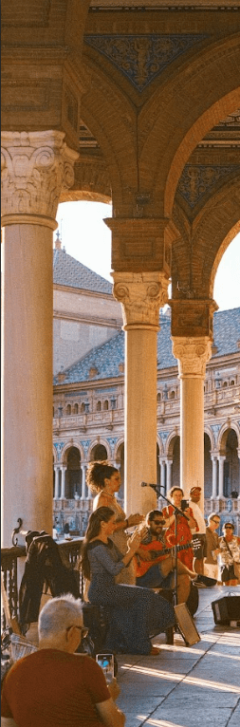
Here’s another section! What extra information does it give you about the possible theme of today’s lesson?
  Describe what you see.
  Does this extra section confirm what you said before?
  Try to guess what the middle section will show.
www.emmateachesenglish.org

Slide 4
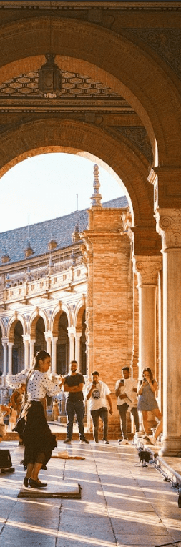
¡Olé! Feel the flamenco
  Tell me about your experience with flamenco.
  Give me three adjectives to describe how flamenco makes you feel. Explain your choices.
  What do you know about the history of flamenco?
www.emmateachesenglish.org

Slide 5
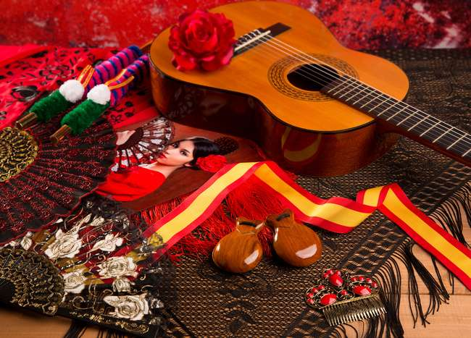
You are going to watch a video called ‘The truth about flamenco's origins’. First, complete the vocabulary matching task.
www.emmateachesenglish.org

Slide 6
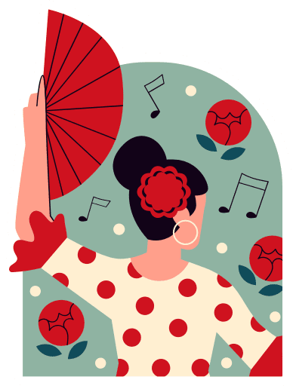
Discussion: Look again at these phrases from the video we will watch. Try to guess which cultures influenced flamenco and explain your answer.
Flamenco is a unique art form that encompasses passion, singing, music and dance, fuelled by guitars and filled with emotion.
We will delve deeper into the two disputed theories of flamenco’s origins.
The soulful singing drew inspiration from....
..........influences also seem woven into flamenco dancing.
Many Spaniards attribute flamenco’s roots to ...
... scattering across Europe, and beyond....
Flamenco likely emerged from a blend of cultures resulting from multicultural coexistence.
www.emmateachesenglish.org

Slide 7

Watch the video and listen carefully to the speaker . We will answer these questions after:
- Were your predictions correct?
- What are the two theories? Which holds more weight in your opinion?
- Was there anything in the video which surprised you?
www.emmateachesenglish.org

Slide 8
Prepositions practise
www.emmateachesenglish.org

Slide 9
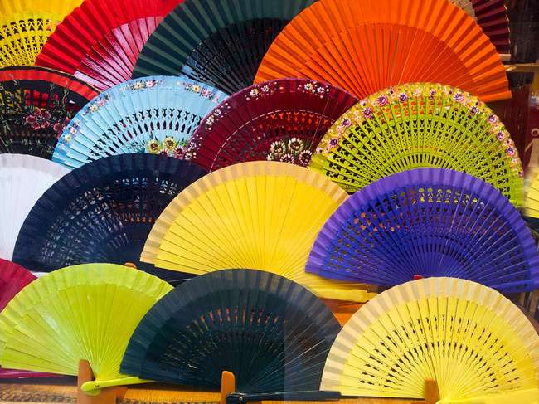
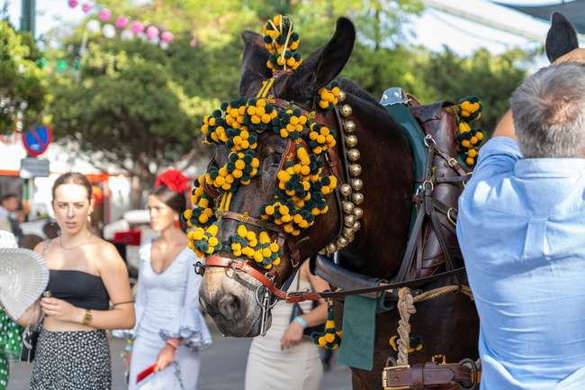
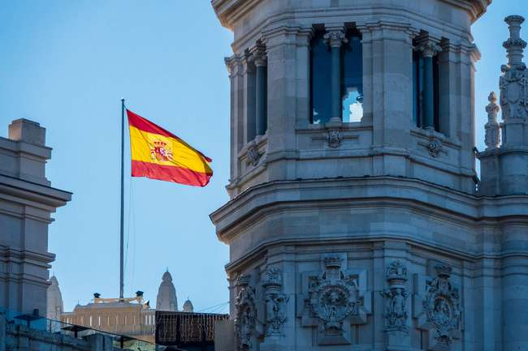
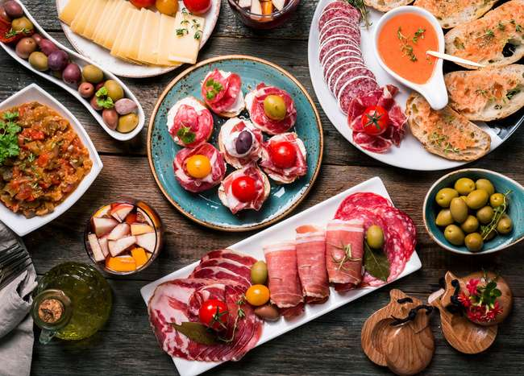
Discussion: We’ve learned that flamenco was influenced by North African and Romani cultures. Can you think of other Spanish traditions which could be influenced by other cultures? Explain your answer.
www.emmateachesenglish.org

Slide 10

In your opinion, can any culture be truly ‘authentic’, or is there always going to be influences from elsewhere? Provide examples.
www.emmateachesenglish.org

Slide 11

Let’s talk!
www.emmateachesenglish.org

